Slide 1
Junior CCC Prep – J2
By Hussain M

Slide 2
What We Will Learn
Declaring and inputting variables
If/else statements
While loops
Deriving formula for different situations

Slide 3
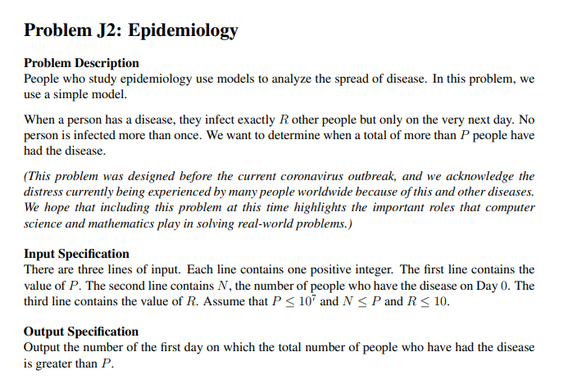
Example J2 Problem: Epidemiology

Slide 4
Break It Down To Smaller Problems

Slide 5
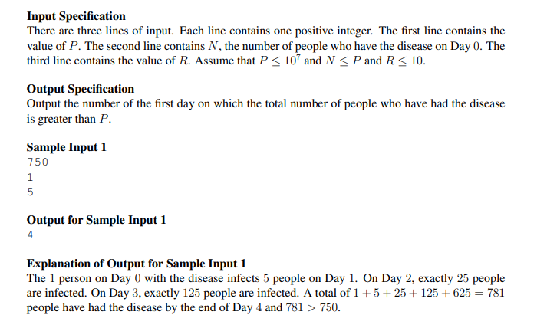
Sub Problems
Collect the input
Check if limit is already reached
Find formula to calculate total infected
Check if the total infected surpasses the limit
Would a loop help here?
If the limit is passed, output the current day

Slide 6
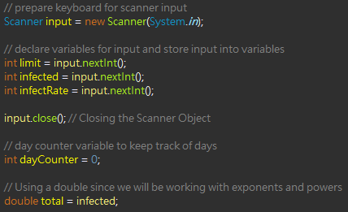
1) Collect The Input
Declare variables for:
P-value (limit value infected people must surpass): limit
N-value (starting number of people infected): infected
Will also be infected people specifically on that day
R-value (# of people infected next day): infectRate
Day counter to keep track of day
Total people infected: total
Store input into these variables
Close scanner (memory leakage, good coding etiquette)

Slide 7

2) Check If limit Reached
Check if the total is greater than or equal to the limit
Total could already greater than or equal limit
This would happen on first day as that is the day we start recording for

Slide 8

3) Formula
As amount of people infected/day is exponentially increasing, we can take the infection rate to the power of the day to find the amount of people infected that day
*Rate: 2 infected/day

Slide 9
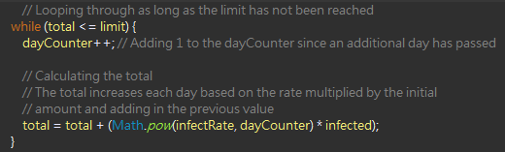

3) Formula (Continued)
Firstly, ensure to put formula in while loop as we constantly check if limit is reached
Add 1 to day counter
Calculate total infected by adding up 2 parts:
Total infected previously + (infection rate to power of day $×$ amount of people infecting)

Slide 10

4) Output day
Lastly, output the day that the total infected surpasses the limit

Slide 11
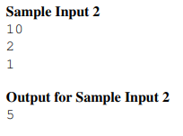
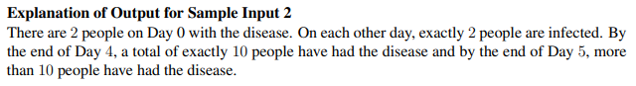
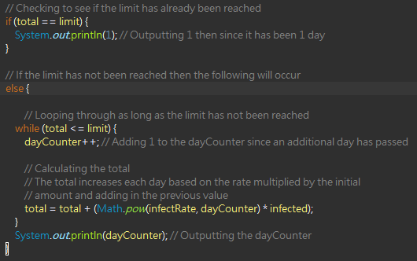
Just to Recap
 | Day 0 | Day 1 | Day 2 | Day 3 | Day 4 | Day 5
Limit surpassed? | No | No | No | No | No | Yes
Previously Infected | 2 | 4 | 6 | 8 | 10
Newly Infected | 2 | 2 | 2 | 2 | 2
Total infected | 4 | 6 | 8 | 10 | 12

Slide 12
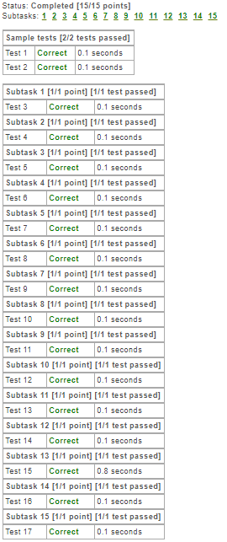
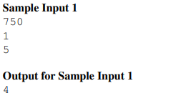

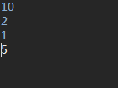
Test Your Solution

Slide 13
